Slide 1



Consumer UI/UX on DataLucent
Step by Step Walkthrough

Slide 2
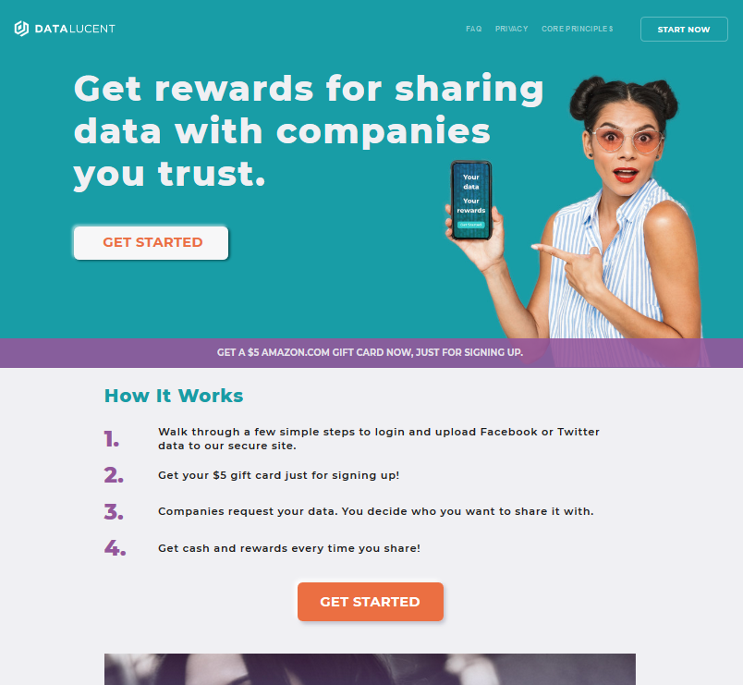
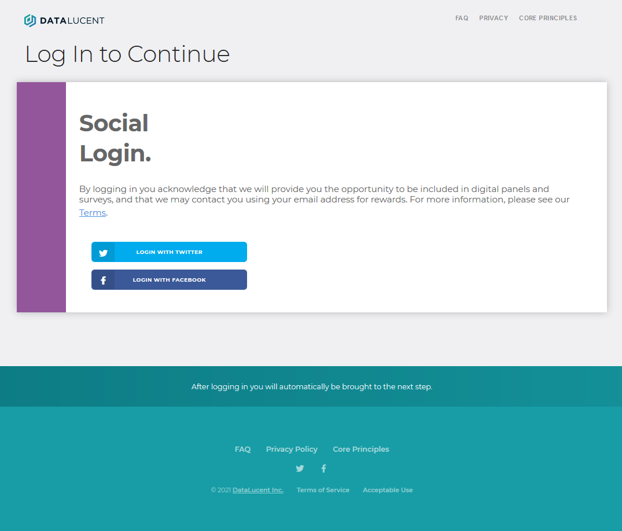
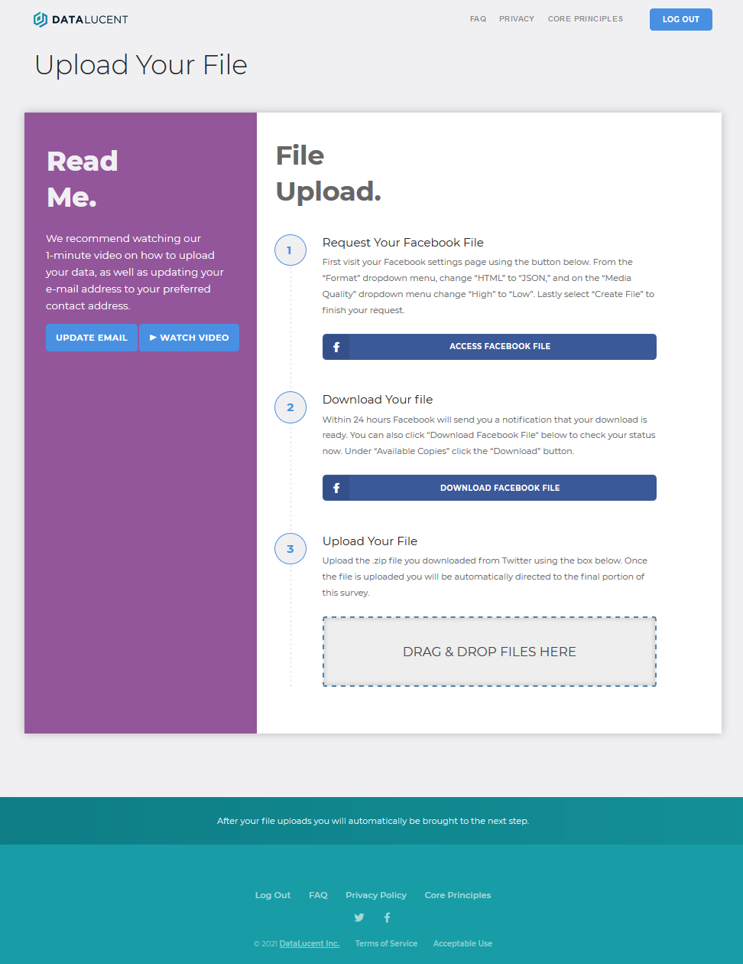
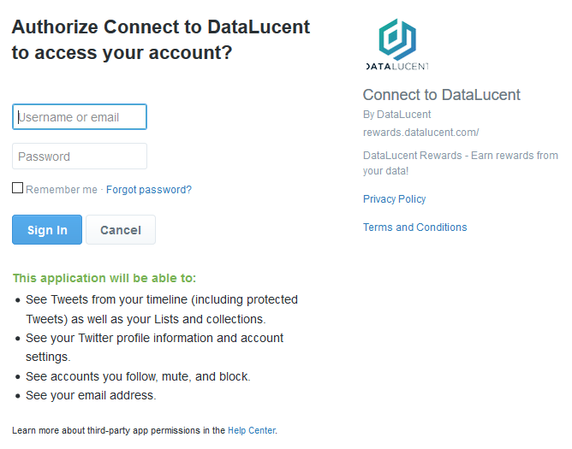
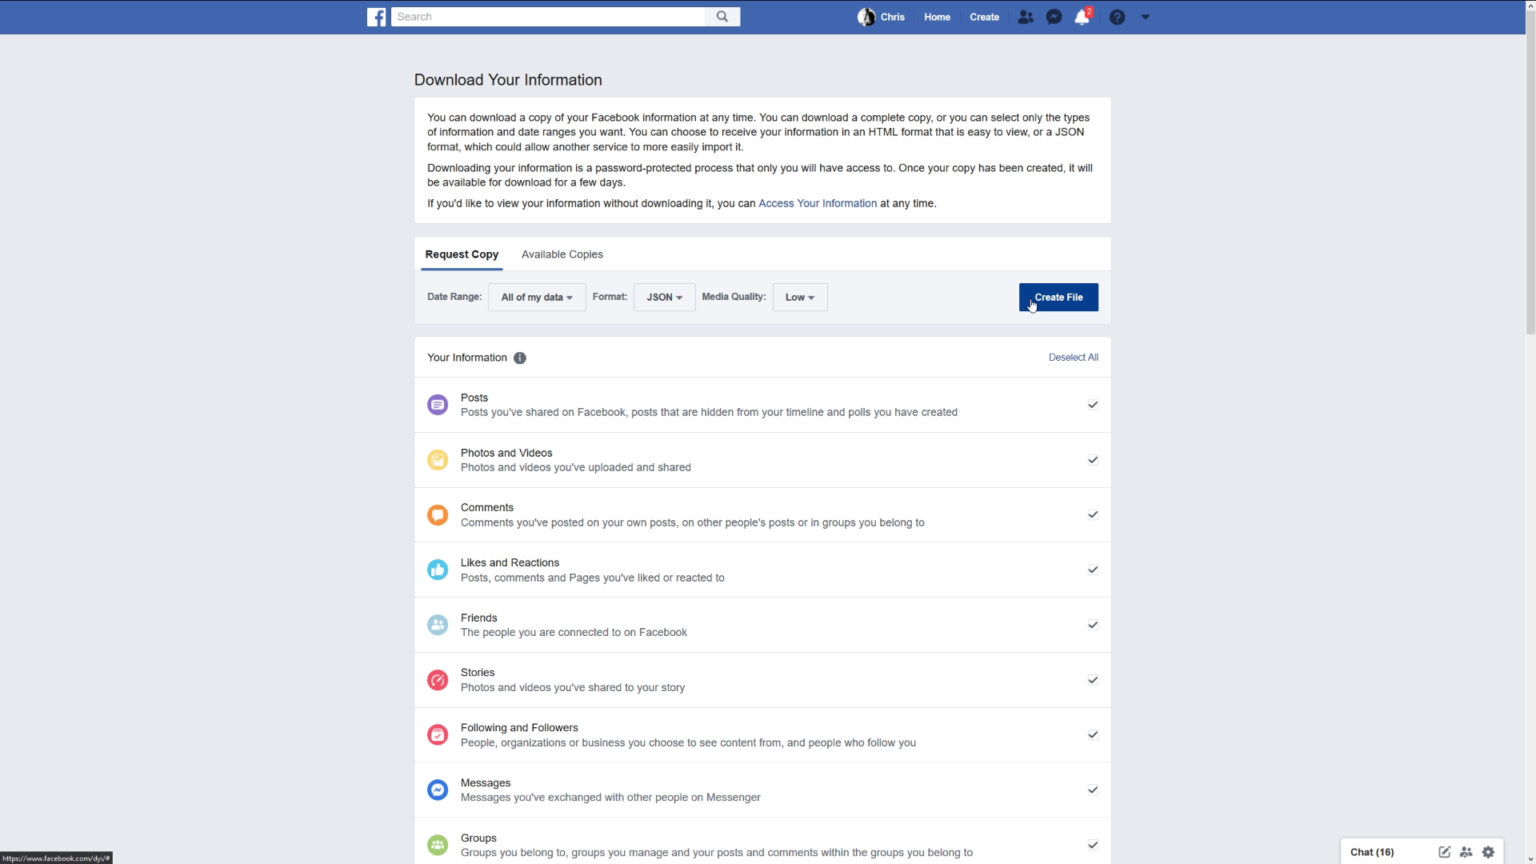
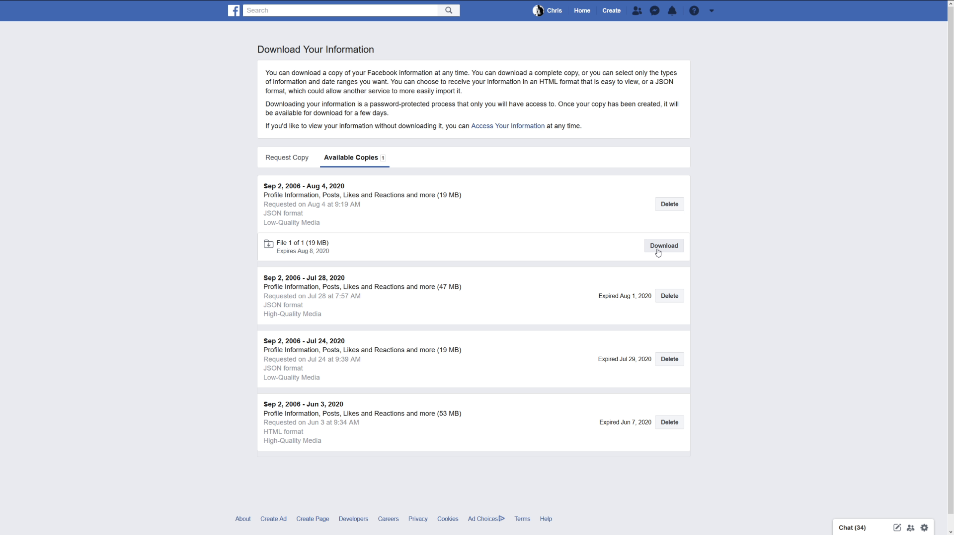
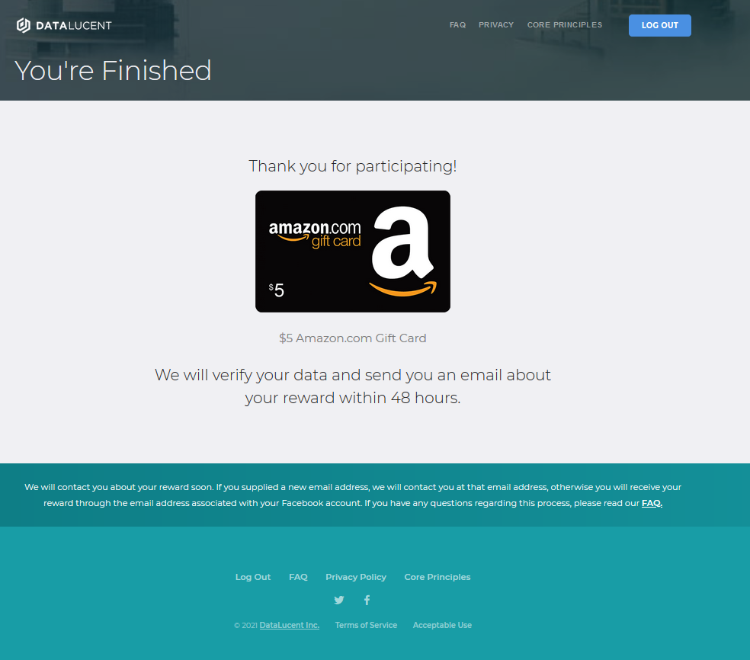
Full UI/UX Storyboard (Facebook)
Landing Page
Login Page
Data Instructions
Account Authorization
>1 min
1 min
2 min
1 min
Request FB File
Download FB File
Upload File
Completion Page
1 min
10 min – several hours
> 5 min
1 min

Slide 3
Landing Page
Every landing page is customized for each campaign.
The focus of the page is to funnel users into the upload process and provided background on how it works.
The incentive is featured prominently on the banner.
The page

Slide 4

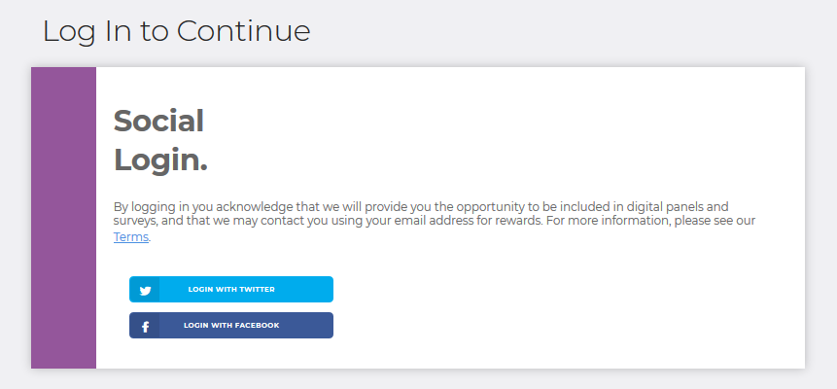
Social Login
The user can choose the social media outlet they prefer.
Logging in is an acknowledgement and agreement to Terms & Conditions.

Slide 5
Grant Approval to Connect
After the user chooses which social outlet they prefer, they will be prompted by the social outlet to approve the connection.
To the right is Twitter’s login approval page. This is standard for social logins throughout the web.
If the user is already logged in to the social media outlet on their device, they do not have to enter their username and password again.

Slide 6

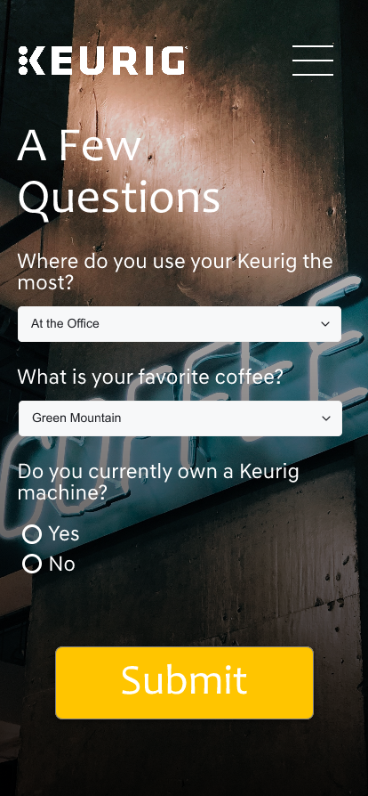
Optional Survey
An optional survey component may be included in the process.
The survey can come before or after the file upload.
This is an opportunity for the brand to ask burning questions of their customers and increases the overall value of the process to the brand.

Slide 7

File Request
Twitter
After logging in to the social media outlet of their choice, the user is directed towards instructions on how to acquire their data.
This typically involves visiting the settings or privacy page of their social media account and requesting a copy of their data.
Once the request is entered, the user must wait for their file to become available.
Some requests are instant while others can take 24 hours; this depends largely on how much media (photos/vidoes) the user has in their social media profiles.
Facebook

Slide 8
File Ready Push Notification
All social media outlets will send a push notification to the user when their file is ready.
Depending on the user’s settings, the notification may also display on their phone.
They can also be reminded through email from DataLucent to check for their file.

Slide 9
File Download
Twitter
Once the user receives a push notification that their file is ready, they are prompted to return to the page on the social media outlet where they requested the file.
Once there, the user then enters in their password, clicks download, and is prompted by their device to download the file.
Each device has a unique download prompt, but all of them work the same way: the file is placed in a downloads folder.
Facebook

Slide 10
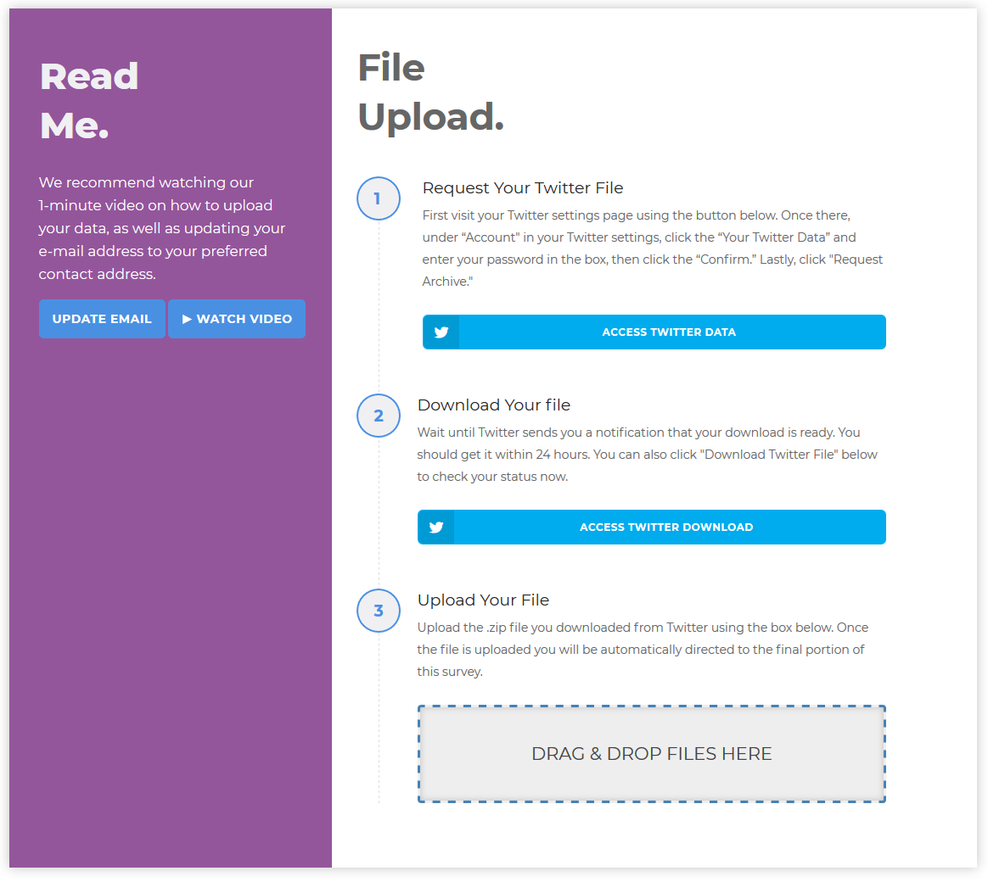
File Upload
Once the file is downloaded, the user returns to the DataLucent upload page and uploads their file.
The user can update their email address to their preferred contact email, and a one-minute YouTube tutorial is provided.
Our upload process is resilient and can resume if the device is locked or goes into standby.

Slide 11
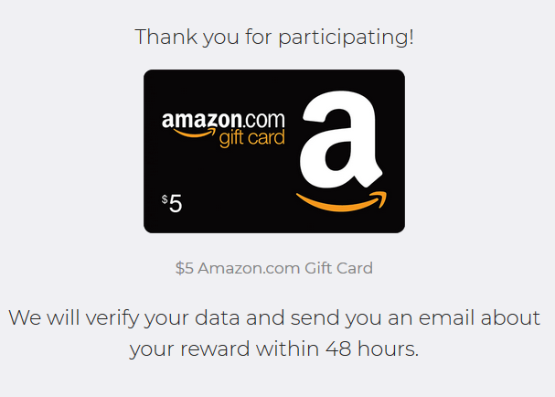
Prize Page
At this point the process is completed and the user awaits their prize.
DataLucent checks the data for validity and the reward is sent to the user within 48 hours.

Slide 12
Backend Data Review
DataLucent receives the files in a storage bucket to review them for validity.
Users with valid files receive their incentive through the email provided during the upload process.
Validity entails:
Active account (recent activity)
Older account (not just created).
Appropriate data indicators (not a bot or fake account).
Other datapoints depending on the social outlet.

Slide 13
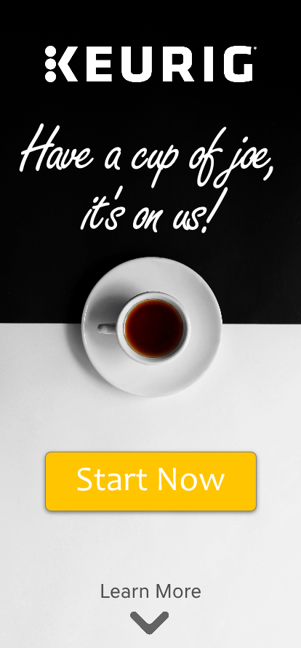
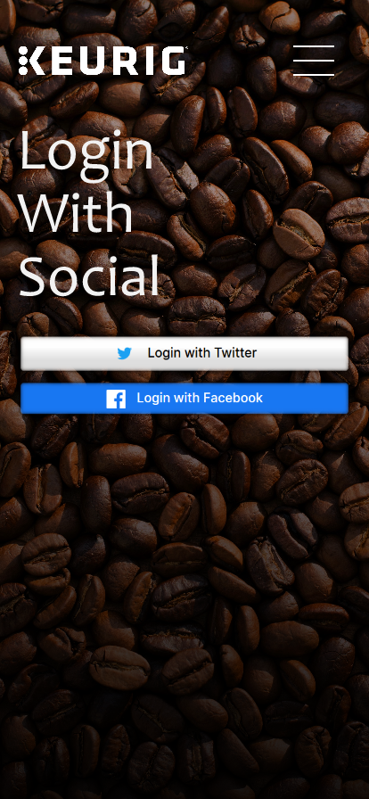
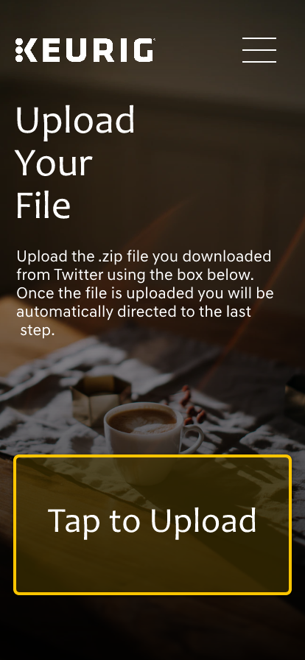
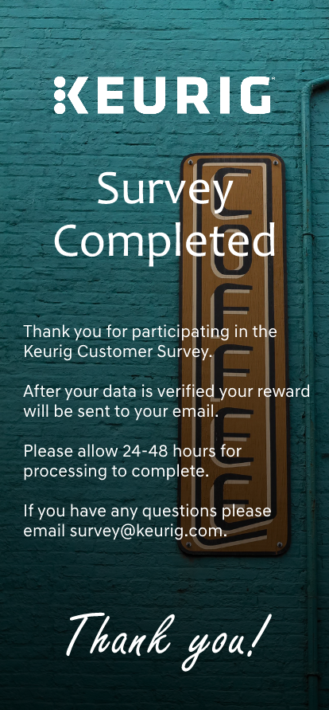
Sample Keurig App

Slide 14
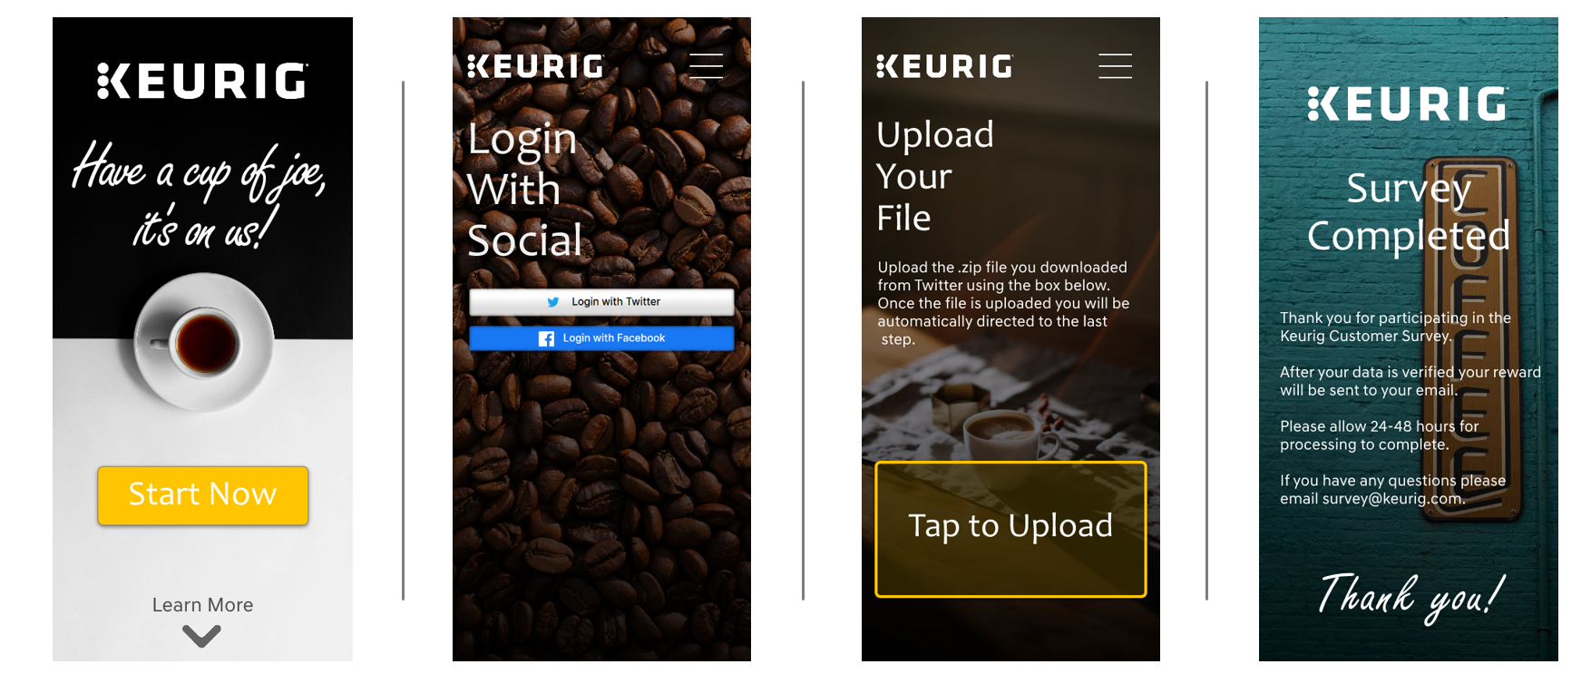
Sample Keurig App

Slide 15
Fin

